Slide 1
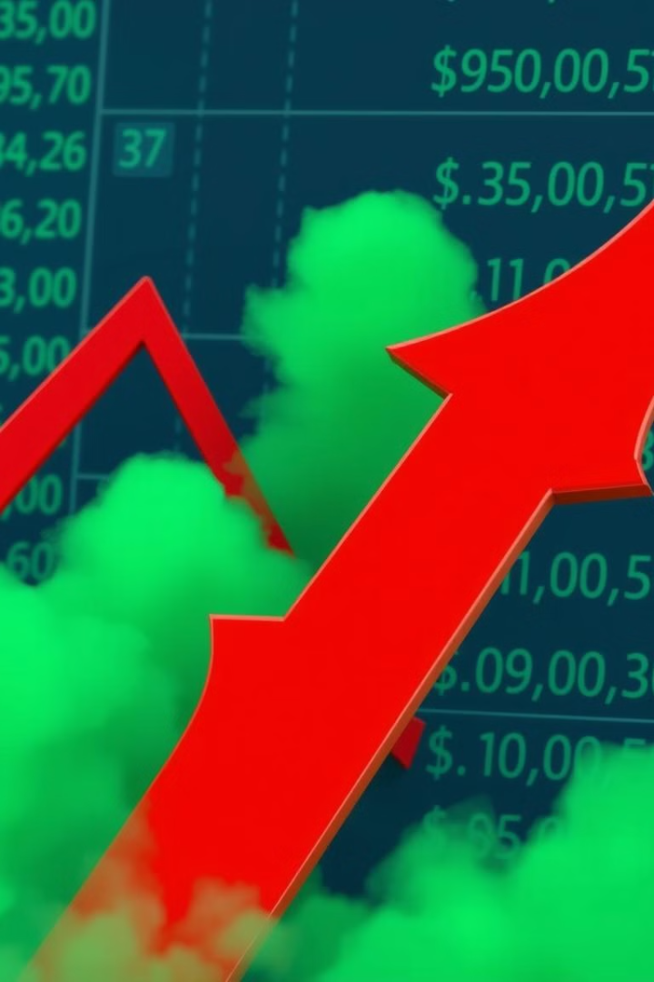
Suspicious Swings: Investing Pre-Event Patterns
This project investigates pre-event trading patterns to detect potential insider trading.
by Vaaman Sonathi

Slide 2
Understanding Insider Trading
Overview
Regulation
Insider trading involves buying or selling a company’s stock based on significant non-public information. This means that individuals with privileged access—such as executives, employees, or close associates—use confidential data that the general public doesn't have to make investment decisions.
People indulging in insider trading have an unfair advantage over the average trader. Hence Insider trading is a criminal offence. In India insider trading investigations are primarily conducted by the Securities and Exchange Board of India (SEBI).

Slide 3
Patterns and Market Impact
Patterns
Market Impact
Insider trading often involves unusual activity prior to significant events. For example, an increase in volume before a merger announcement. These patterns are indicators that can be exploited to identify potential insider trading.
Insider trading can significantly affect market efficiency and fairness. Individuals with privileged information can make profits unfairly, harming other investors. This project aims to build models that can identify these patterns and help prevent such occurrences.

Slide 4
Choosing Companies for analysis
Patterns
Market Impact
Insider trading often involves unusual activity prior to significant events. For example, an increase in volume before a merger announcement. These patterns are indicators that can be exploited to identify potential insider trading.
Insider trading can significantly affect market efficiency and fairness. Individuals with privileged information can make profits unfairly, harming other investors. This project aims to build models that can identify these patterns and help prevent such occurrences.

Slide 5
Choosing Companies for analysis
1
Mainly Large cap companies are chosen as they tend to follow market trends, so any irregular pattern can be easily identified.
2
Companies such as Infosys and CIPLA which have been previously investigated for insider trading by SEBI.
3
Companies that have executed numerous mergers and acquisitions so as to give many time periods of analysis .

Slide 6
Data Collection and Preprocessing: Building Our Detection Framework
1
The raw stock data contains price points and volumes for each trading day. Not adequate to detect trends and abnormalities
2
The data is preprocessed to create variables such as volatility, volume change and zscores, daily returns.
3
Expected returns are calculated to compute abnormal returns using linear regression.

Slide 7
Models
Since the data is mostly unlabeled as even the SEBI investigations were not always proven, the way to detect insider trading is essentially anomaly detection. For this project, i tried three different models.
Statistical model
Isolation Forest
DBSCAN

Slide 8
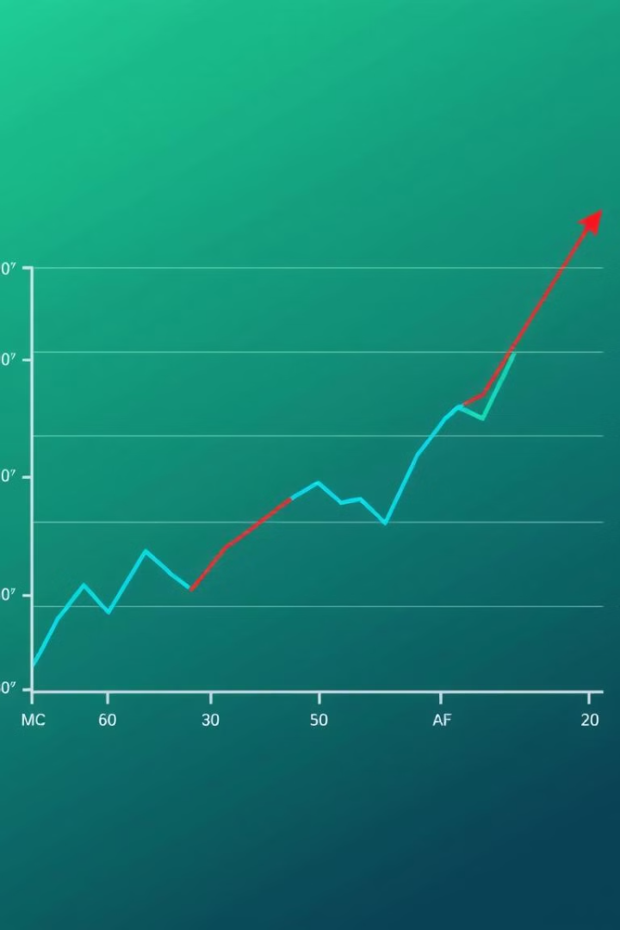
Statistical Model:
Anomaly Detection
Fundamentals
If the z scores are greater than a set threshold, the corresponding date is flagged . If the flagged date is within 30 trading days of a major announcement, this can be a sign of insider trading.
Detects anomaly by checking the returns z score and volume z score.
Limitations
Low complexity means high chance of false positives. Lots of reasons other than insider trading for high zscore.

Slide 9
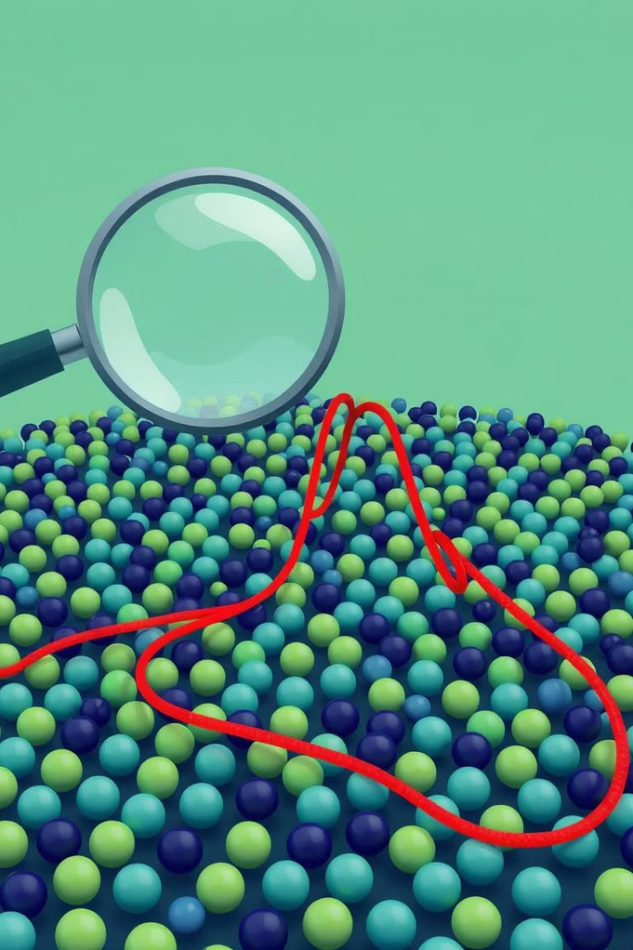



Isolation Forest: Identifying Market Outliers
Tree-Based Approach
Outlier Detection
Market Insights
This model builds an ensemble of decision trees to isolate anomalous data points, identifying suspicious trading patterns.
The Isolation Forest model effectively identifies outliers by measuring the distance between data points.
This approach helps identify trading activities that deviate significantly from typical market behavior.

Slide 10
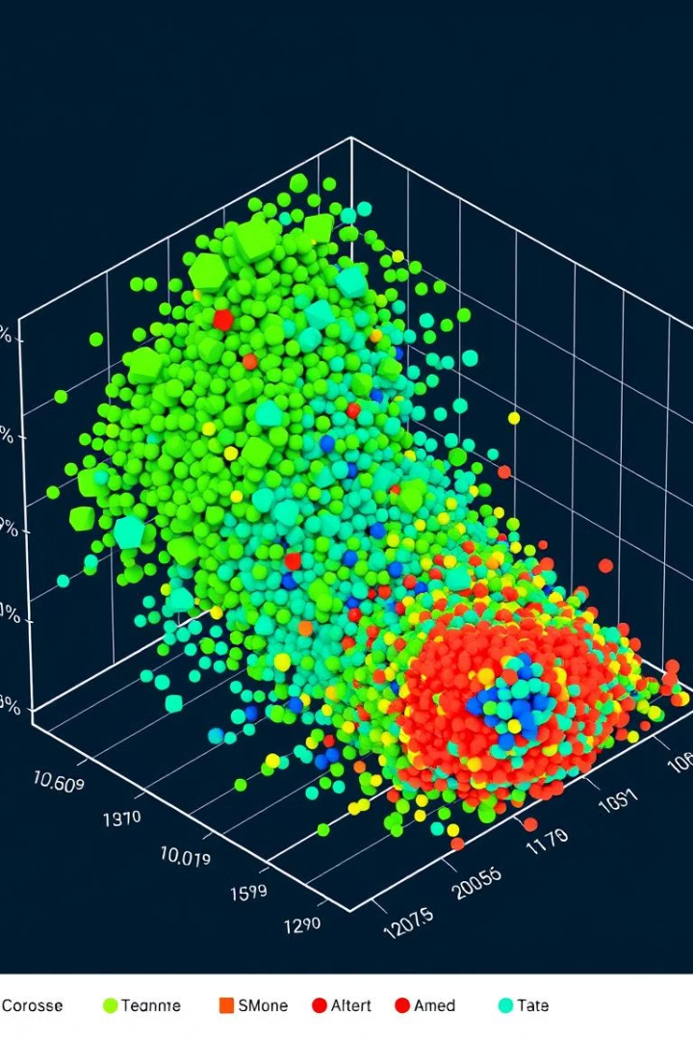
DBSCAN: Clustering Suspicious Trading Patterns
1
Clustering
We used DBSCAN to cluster trading patterns, identifying groups of similar behaviors that could be indicative of insider trading.
2
Density-Based Analysis
DBSCAN identifies dense regions of data points, clustering them into groups based on their proximity.
3
Suspicious Clusters
Clusters with abnormal density or distinct features from other clusters might point to suspicious trading activity.

Slide 11
Analysis of selected companies
For all the companies i investigated, all three models gave mostly similar results but isolated forest was slightly better as it gave an anomaly score and not just a binary flag. It also showed better results when testing against cases where insider trading was previously detected by SEBI.
As mentioned previously, certain criterion was considered while choosing companies, and as for each company, hyperparameter analysis had to be performed, only a few gave very good results.
I

Slide 12
Infosys
From 2018-2020, regulators noticed abnormal spikes of infosys stock price right before key announcements such as financial earnings announcements. The charge was later dropped due to lack of evidence but stock was kept on the watch .
Statistical model showed volume spikes on the day of announcement itself. Isolation forest also flagged the announcement day as an anomaly for 5 of 7 of the days.
Infosys releases announcements after market hours so this can be an the sign of insider trading.
Furthermore, for days of announcements before 2018 and after 2021, not once was the announcement day flagged. This provides useful evidence on insider trading in infosys.
I

Slide 13
ITC
ITC was chosen for analysis due to the numerous acquisitions it has made in the past.
Over the last 10 years, major acquisitions of ITC include sunrise foods, savlon, charmis, etc.
All 3 models flagged the day 20 days prior to the announcement of sunrise foods acquisitions. Significant surge in volumes and returns were observed.
Anomalies were also detected for Savlon and Charmis as well 20 days in the past but anomaly was of a lower magnitude.
On decreasing contamination of isolated forest to 1%, anomaly still persisted.
I

Slide 14

Conclusions and Future Applications in Market Surveillance
This project showcases the potential of pre-event pattern analysis to detect insider trading. Our models have identified suspicious trading activity in quite a few cases and can be used to indicate insider trading as a market surveillance system tool to improve market efficiency and fairness. Future research can explore more complex models and incorporate real-time data analysis.

Slide 15
References
Insider Trading Patterns(https://www.sciencedirect.com/science/article/pii/S0929119920300985)
https://epjdatascience.springeropen.com/articles/10.1140/epjds/s13688-024-00500-2
I

